Slide 1
Scaling Distributed Machine Learning with In-Network Aggregation
Amedeo Sapio, Marco Canini, and Chen-Yu Ho, KAUST; Jacob Nelson, Microsoft;
Panos Kalnis, KAUST; Changhoon Kim, Barefoot Networks; Arvind Krishnamurthy,
University of Washington; Masoud Moshref, Barefoot Networks; Dan Ports,
Microsoft; Peter Richtarik, KAUST
NSDI 2021

Slide 2
Outlines
Background and motivation
Design
Evaluation

Slide 3



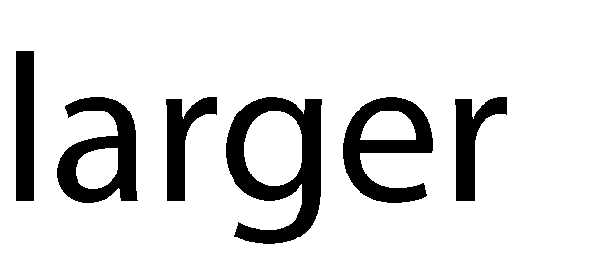


Background and motivation
Machine learning
1
Innovation fueled by leaps in (costly) infrastructure:
Clusters with hundreds of machines, each with many HW accelerators (GPUs)
Compute requirements doubling every 3 months!
Training models is still very time-consuming: days or even weeks!

Slide 4


Background and motivation
Distributed learning
Data parallelism
$x^{t+1}=x^{t}+\sum_{i=1}^{n}{∆(x^{t},D_{i}^{t})}$
$D_{i}^{t}$ is the data subset at worker $i$ during that iteration
Model parameters at iteration t
$∆\left(∙,∙\right)$ is the model update function
Network communication: aggregation

Slide 5


Background and motivation
Distributed training
Data parallelism
computation
Network communication
bottleneck

Slide 6
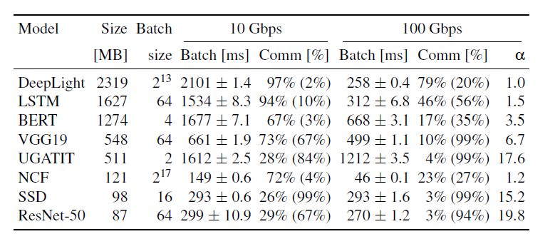
Background and motivation
When is the network a bottleneck
Batch [ms]” reports the average batch processing time and its standard deviation
“Comm” reports the proportion of communication activity as % of batch time.

Slide 7


Background and motivation
Existing methods
Parameter Server (PS)
Parameter Servers (PS)
PS 1
$$a^{′}=a_{1}+a_{2}+a_{3}+a_{4}$$
Workers
a₁ b₁
Worker1
a₂ b₂
Worker2
a₃ b₃
Worker3
a₄ b₄
Worker4
Gradients

Slide 8




Background and motivation
Existing methods
Parameter Server (PS)
Parameter Servers (PS)
PS 1
$$a^{′}=a_{1}+a_{2}+a_{3}+a_{4}$$
Network could be bottleneck for distributed training
Workers
a₁ b₁
Worker1
$$a^{′}$$
$$a^{′}$$
$$a^{′}$$
a₂ b₂
Worker2
a₃ b₃
Worker3
a₄ b₄
Worker4
$$a^{′}$$
Gradients

Slide 9
Background and motivation
Existing methods
The all-reduce approach
A collective communication technique to combine model updates
E.g., Ring topology
Each worker communicates to the next neighboring worker on the ring
Drawback
Latency grows with the number of workers

Slide 10
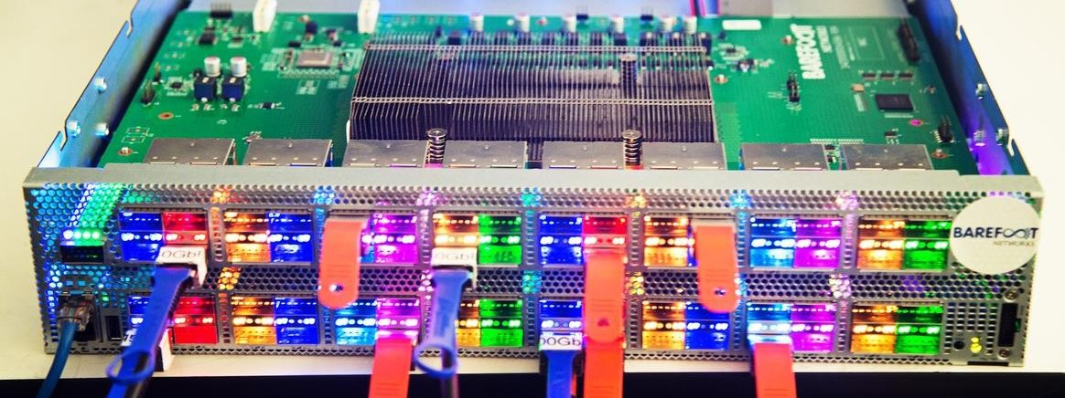
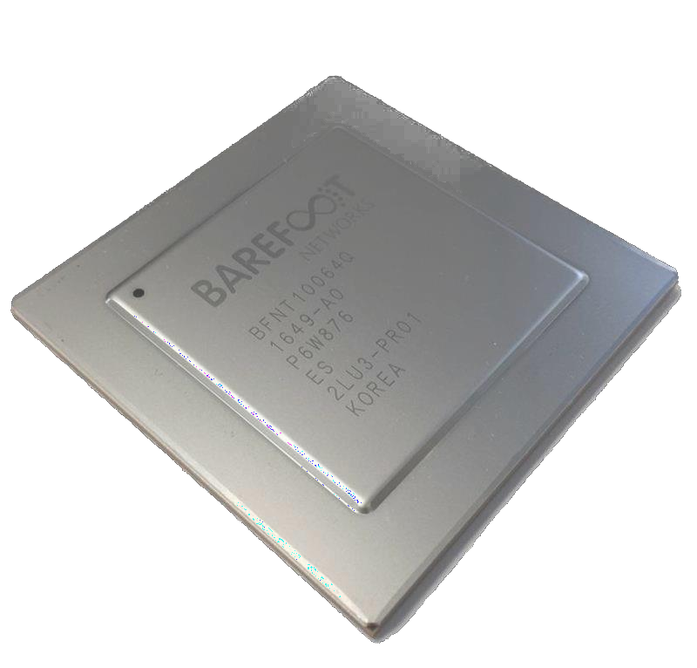


Insight
100Gbps line rate processing
Programmable switch

Slide 11
Outlines
Background and motivation
Design
Evaluation

Slide 12
SwitchML: Co-design ML and networking
In-network aggregation for distributed training
Challenges:
Limited computation
No floating-point
Limited storage
Packet loss
Design:
Combined switch-host architecture
Switch performs integer aggregation
End-hosts manages reliability and performs more complex computations
Pool-based streaming aggregation
Stream aggregation through the switch
Fault tolerant protocols
Quantized integer-based aggregation

Slide 13
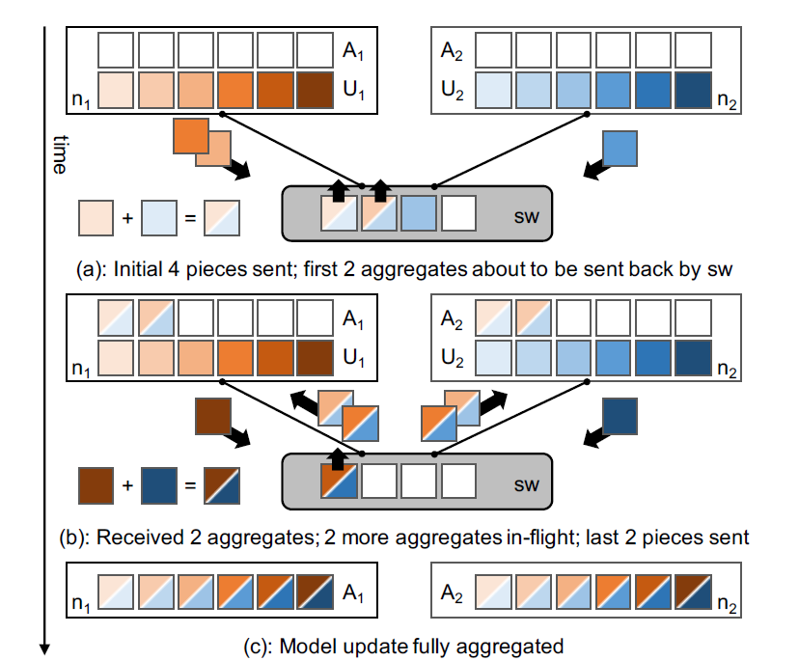
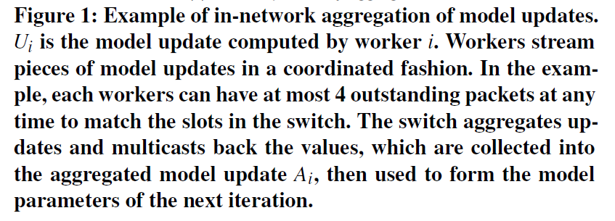
SwitchML

Slide 14
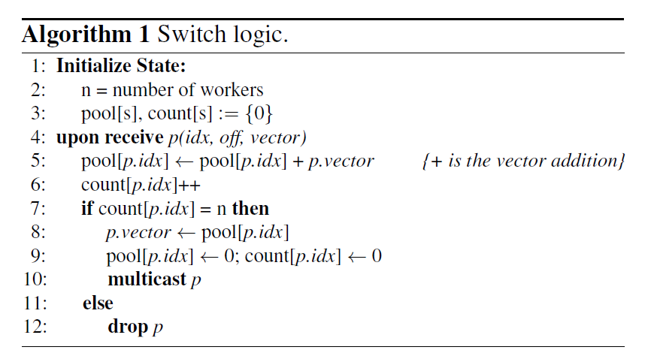
Switch-side aggregation protocol
A SwitchML switch provides a pool of s integer aggregators
Each slot in the pool aggregates a vector of k integers
Aggregate pieces of the model in a streaming fashion
Today’s programmable switches parse only up to a certain amount of bytes (k is 64 or 256.)
Send a copy of the packet to each worker

Slide 15
Worker-side aggregation protocol
Roles
Determine which aggregator in the pool to use and when
Determine which piece of vectors to send
Considerations
Correctness
Every worker must use the same slot for the same piece of the model update
No slot can be simultaneously used for two different pieces
Performance
Every work must work on the same slot at roughly the same time
Avoid long synchronization delays

Slide 16
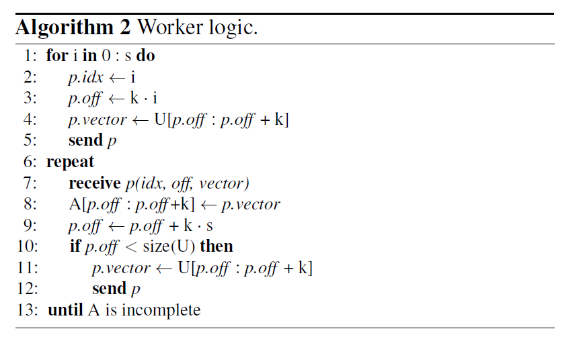
Worker-side aggregation protocol
Send s packets, each initial packet is assigned sequentially to one of the s aggregation slots.
Send remaining pieces after receiving an aggregated result.

Slide 17
Worker-side aggregation protocol
The coordination of different workers is implicit

Slide 18
Packet loss
Packet loss can happen
Corruption or network congestion
With the previous algorithm, even one single packet loss can halt the whole system
Worker -> switch: prevent the switch from completing the parameter updates
Switch -> worker: prevent a worker from learning the result and completing aggregation
Solution
Retransmit lost packets
If a worker does not receive a response packet from the switch in a timely manner
Retransmit the packet

Slide 19
Packet loss
Potential problems
A model update could be applied twice to the aggregator
Wrong result (the response was lost)
If a worker retransmit a packet for a slot that was already fully aggregated
Challenges
Differentiate packets that are lost on the upward paths versus the downward ones
Retransmit an aggregated response that is lost on the way back to a worker

Slide 20
Packet loss
Solutions
Design I
Record which workers have already contributed updates to a given slot
Design II
A shadow copy of the previous result for each slot
A single bit to distinguish the two active phases for any slot

Slide 21
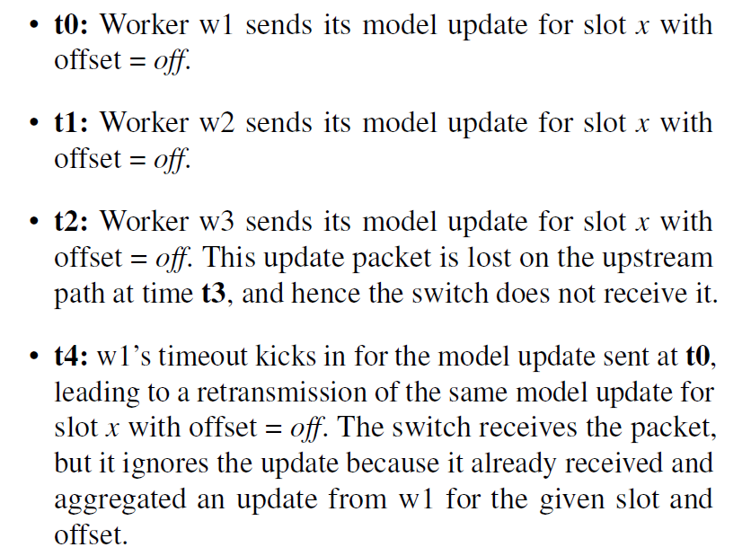

Packet loss solutions: example
Three workers $w_{1},w_{2}, w_{3}$

Slide 22
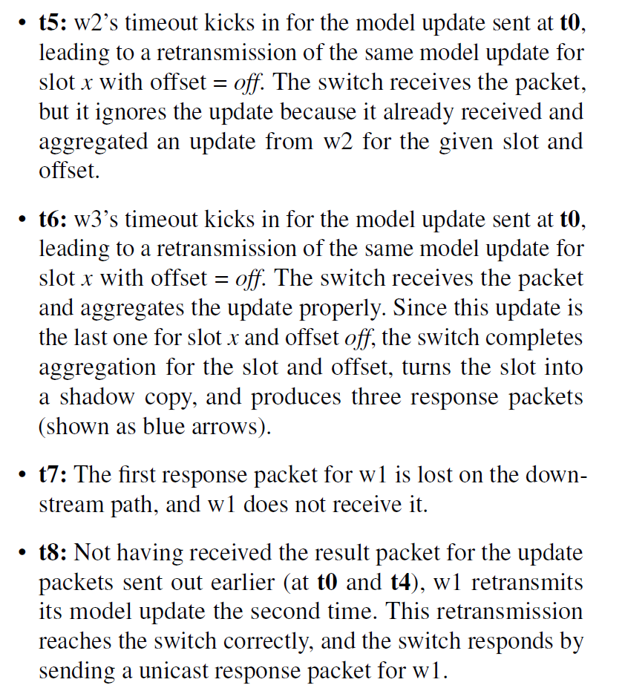
Packet loss solutions: example

Slide 23
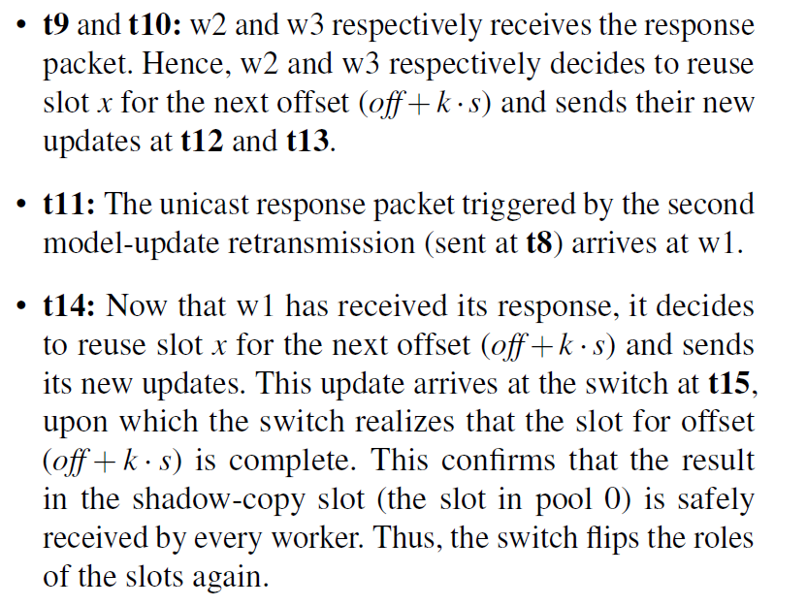
Packet loss solutions: example

Slide 24
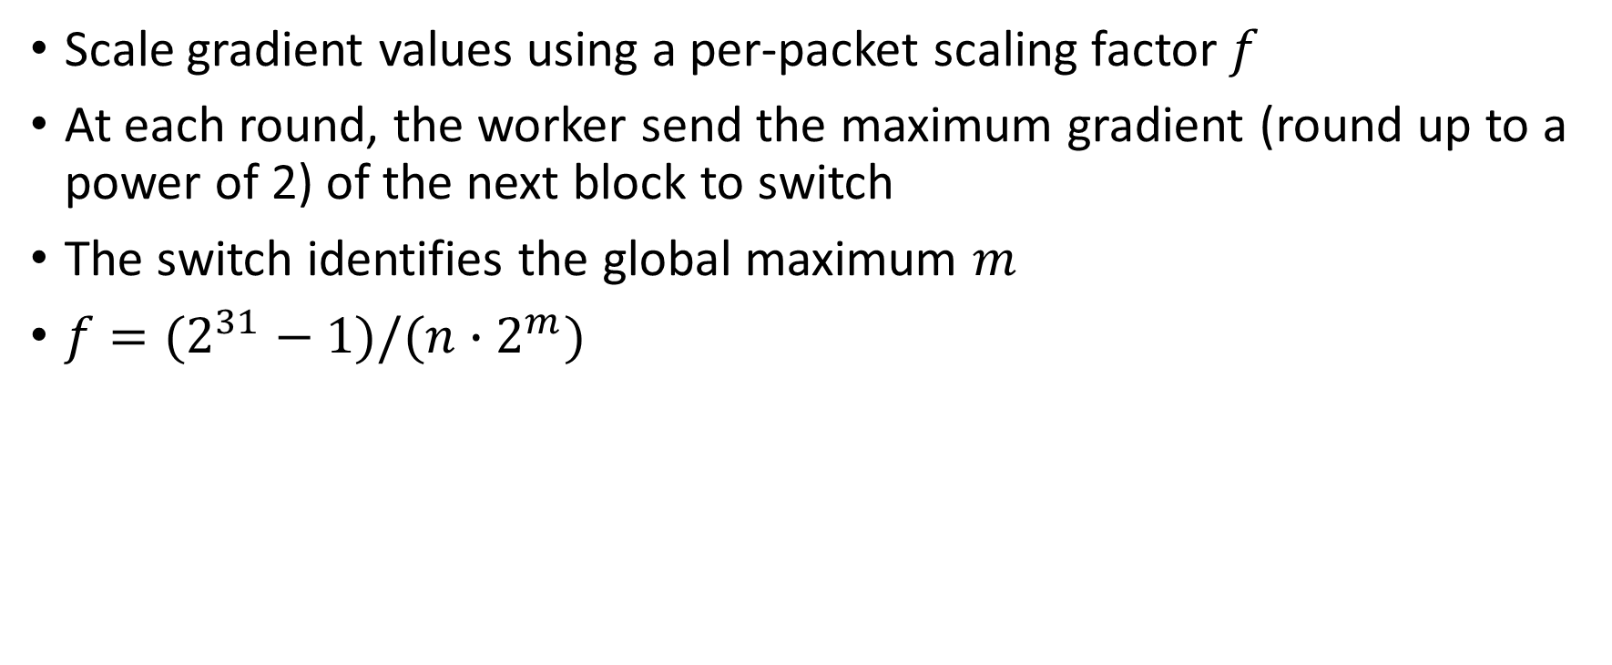
Floating-point numbers
Scale gradient values using a per-packet scaling factor $f$
At each round, the worker send the maximum gradient (round up to a power of 2) of the next block to switch
The switch identifies the global maximum $m$
$f=(2^{31}−1)/(n∙2^{m})$

Slide 25
Outlines
Background and motivation
Design
Evaluation

Slide 26
Implementation
The worker is built atop Intel DPDK
The P4 program distributes aggregation across multiple stages
The switch processes 64 elements per packet using one switch pipeline
The switch processes 256 element using four switch pipelines
Support larger packets through recirculation

Slide 27
Evaluation
Testbed
8 machines (GPU)
A Wedge 100BF-65X programmable switch with Barefoot Network Tofino chip
Every node is networked at both 10 and 100 Gbps
Performance metrics
Tensor aggregation time (TAT)
Start: the time a worker is ready to send it
Stop: the worker receivers the aggregated tensor
Aggregated tensor elements (ATE) per unit of time
Benchmarks
8 DNNs

Slide 28
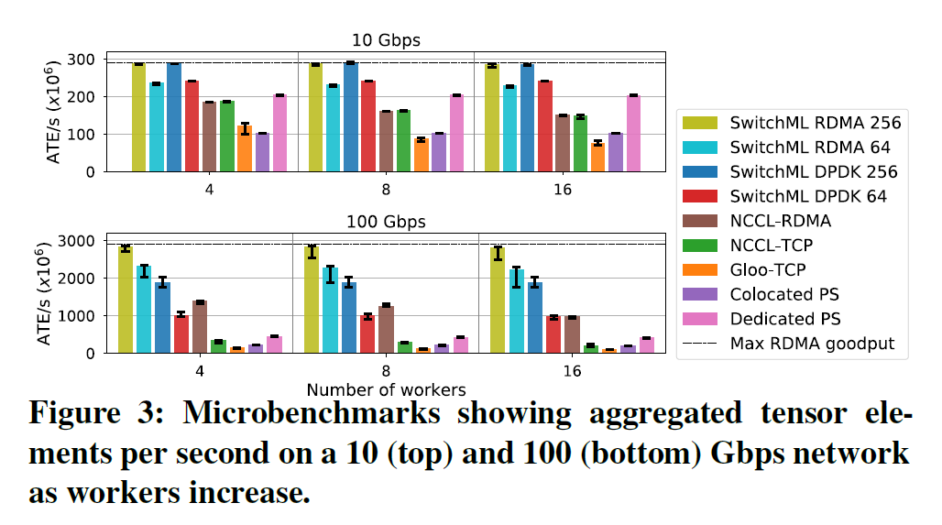
Tensor aggregation microbenchmarks
Efficiency of SwitchML in comparison to other communication strategies

Slide 29
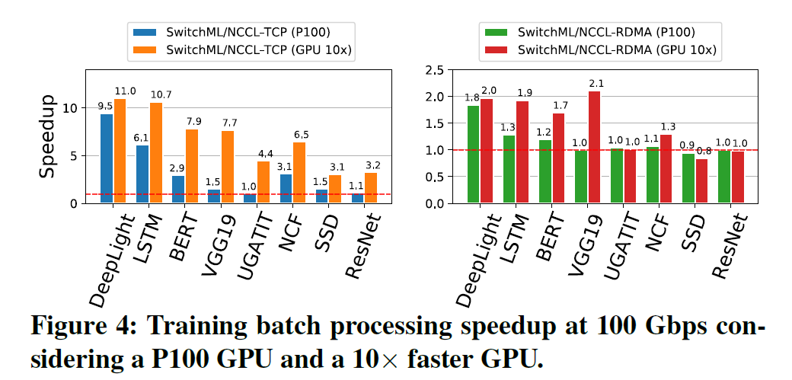
SwitchML improves training speed
SwitchML accelerates batch processing.

Slide 30
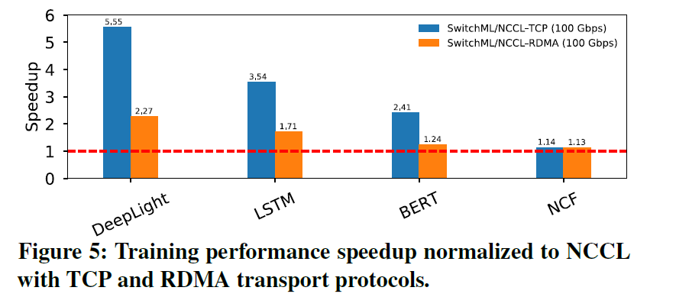
SwitchML improves end-to-end training

Slide 31
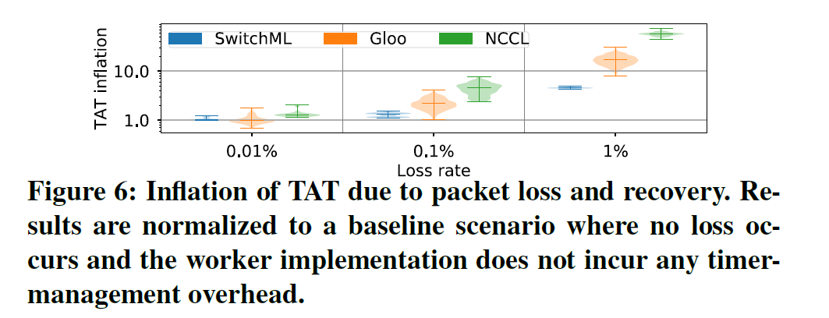
Overheads
Packet loss recovery

Slide 32
Extensions (limitations)
Scaling beyond a rack
If large scale ML jobs span beyond a single rack
Congestion control
Multi-job (tenancy)
Allocate resources for different jobs
Privacy

Slide 33
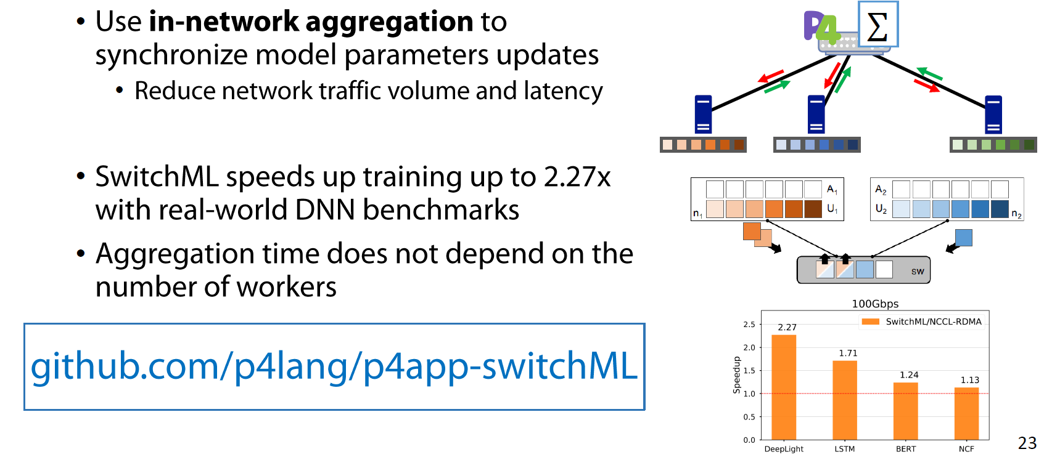
Conclusion

